Slide 1
Welcome to eSentire
Managed Detection and Response
November 2021

Slide 2
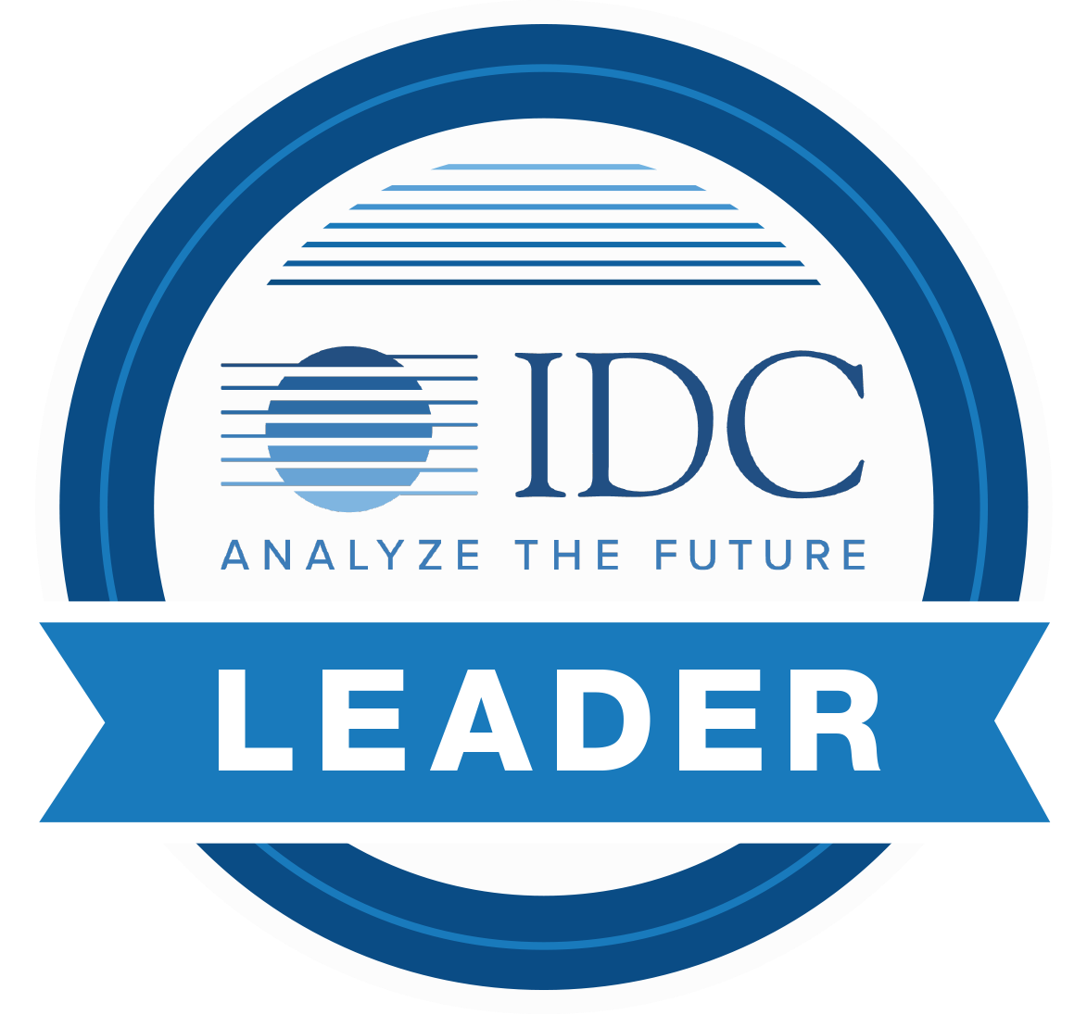
The Authority In Managed Detection And Response
eSentire’s mission is to hunt, investigate and stop cyber threats before they disrupt your business.
2
Security Operations Centers
24/7
Threat Hunting and Support
5
Patents in Machine Learning
Founded in 2001
Customers: 1000+
Countries: 70+
Employees: 500+
SOC
SOC
Cork
Waterloo
Seattle
London
New York
20.5M
Daily Signal Ingest
3M
Daily Atlas XDR Automated Disruptions
6000
Daily Human-led Investigations
Security at Scale across industries:
700
Daily Escalations
Finance
Healthcare
Legal
400
Daily Threat Containments
Insurance
Manufacturing
…and more
15 mins
Mean Time to Contain

Slide 3
Constant Forward Momentum
2019
New Global HQ in Waterloo, Canada
2020
Announced key partnerships with Microsoft and UiPath
2012-2016
Global expansion efforts with equity investments
2018
Kerry Bailey joins as CEO to drive next stage of growth
2001
eSentire founded to disrupt threats in hedge fund environments
2015
SOC opened in Cork, Ireland
2021
Acquired CyFIR and announced complete Cyber Investigations portfolio with 4-hour threat suppression
2018
Acquired Machine Learning leader, Versive
2020
Introduced Atlas XDR Cloud Platform with complete Multi-Signal Capability across Network, Endpoint, Log, Cloud and more
2014
New York and London offices opened
2008
Scaled across industry and launched full Managed Security Service
2017
Partnership and Growth Equity Investment from Warburg Pincus
2019
Expanded expertise across best of breed tech including Crowdstrike and Carbon Black
EXPERTISE IN RESPONSE
GLOBAL EXPANSION
PLATFORM ADVANCEMENT
OWN THE “R”

Slide 4
MACHINE PROBLEM
HUMAN PROBLEM
SOLVE THE PROBLEM
Rapid speed
of business
24/7 coverage
“
Eliminate the noise
Ultimately, business protection comes down to the speed at which you can hunt and contain an attack.
Preventative tools bypassed
+
Resource constraints
Detect known and unknown threats
”
Expanding
data and users
Limited processes
Respond before disruption
No proactive threat hunting
Hunting skillset
Alert overload
and false positives
Remote and
hybrid workforce

Slide 5
Not all MDR is created equal. Here is what you should expect…
24/7 Security Operations
24/7 Threat Hunting
SOLVE THE PROBLEM
Multi-Signal Ingestion
Deep Investigation
Eliminate the noise
Detect known and unknown threats
High Fidelity Detection
Threat Research & Analysis
Respond before disruption
Automated Disruptions
Complete Response

Slide 6
We deliver…
3
MDR
Response. Remediation. Results.

Slide 7
MDR³ Provides Complete Response
Our team doesn’t drown you in alerts. We go beyond MSPs and other MDR providers to drive results.
Machine - Powerful Cloud Platform
Automatically blocks high fidelity malicious threats, cuts noise with patented machine learning models and delivers Security Network Effects to all of our customers
Response
Team - 24/7 Threat Hunting
Human intuition to investigate advanced threats. SOCs staffed 24/7 with Cyber Analysts and Elite Threat Hunters, complemented by our leading Threat Response Unit (TRU)
Remediation
Results
Operations – Security Leadership
Process driven analysis, investigation and response refined over two decades of protecting high value targets
Our expertise in response is unparalleled.
When your preventative controls fail – and they will – we are there to disrupt and contain threats before they become business impacting events.

Slide 8
eSentire’s Industry-Leading Services
Our cybersecurity services portfolio is designed to stop breaches, simplify security and minimize business risk. We provide around-the-clock threat protection that is proactive, personalized and cost effective.
Managed
Risk Services
Managed Detection and Response
Incident Response and Digital Forensics
Strategic services including Vulnerability Management, Managed Phishing and Security Awareness Training to identify gaps, build defensive strategies, operationalize risk mitigation and continuously advance your security program.
We deliver complete and robust Response. By combining our cutting-edge XDR platform, 24/7 threat hunting and security operations leadership, we hunt and disrupt known & unknown threats before they impact your business.
Battle-tested Incident Commander level expertise driving incident response, remediation, recovery, and root cause analysis. Emergency IR services and industry-leading 4-hour Threat Suppression SLA with eSentire Retainer available.

Slide 9
Time To Value In Delivering Security That Scales
Within days you will benefit from end-to-end coverage, complete response and a scalable solution that can grow as your business and data needs expand. We prioritize risk reduction and continuous improvement from Day 1.
Test Defenses
Identify Risk
Mitigate Risk
Measure and Optimize
Management and Support
Visibility
Detection and Blocking
Response
Deployment
Environment Coverage
Threat Framework
Investigation
Tuning
Integration
Identification
Containment
Guidance
Signal Sources
Automation and Orchestration
Remediation
Technology Support
Signal Fidelity
Blocking
IR and Digital Forensics
Insights and Continuous Improvement

Slide 10
Security Without Compromise
MDR
SIGNALS
INVESTIGATION
CORRELATION
RESPONSE
KILL SWITCH
Don’t settle for partial security. Multi-Signal Matters.
24/7
INVESTIGATION AND
RESPONSE
Network
eSentire MDR means multi-signal telemetry and complete response.
NETWORK
ENDPOINT
Endpoint
INSIDER
VULNERABILITY
LOG
CLOUD
Comprehensive Visibility – Layered Attack Surface
24/7 INVESTIGATION
AND
CONTEXT
DRIVERS
Log
Detections Mapped to MITRE ATT&CK® Framework
Cloud
Rapid Correlation & Deep Investigation
Insider
Multiple Points of Contextual Awareness & Response
MVS
Best Chance To Reduce Threat Dwell Time
Notes:
NETWORK – Block malicious IPs, brute force attacks, active intrusions and unauthorized scans
ENDPOINT – Host isolation to protect other assets from ransomware, trojans and more
EMAIL – Social engineering and phishing investigation, control and retroactive deletion
IDENTITY – Stops compromised user and insider threats with cloud active directory response
LOG – Critical visibility and context from your existing security controls and network infrastructure
CLOUD – Configuration escalations, policy & posture management across multi-cloud environments
INSIDER – Detects malicious insider behavior leveraging Machine Learning models
MVS – Prioritized and recommended remediation of vulnerabilities based on scanning cadence

Slide 11
Without eSentire = Signal Confusion and False Positives
SIGNALS
DATA OVERLOAD
Network
Endpoint
?
Log
YOU
Cloud
Insider
Vulnerability

Slide 12
Our Powerful Platform Drives Response Capabilities
The Atlas XDR Cloud Platform is the foundation of eSentire MDR.
SIGNALS
Network
ATLAS XDR CLOUD PLATFORM
Endpoint
Log
MADNESS
URGENCY
RESPONSE
YOU
Cloud
Insider
Vulnerability

Slide 13
How It Works
Cloud-native architecture. Proprietary machine learning. Extensive response capabilities.
SIGNALS
eSENTIRE THREAT RESPONSE UNIT (TRU)
Proactive hunting and research Develops detection models Intelligence and analytics
Network
ATLAS XDR CLOUD PLATFORM
Endpoint
Cloud-Native Platform Machine Learning Models Automated Disruptions
24/7 SOC
eSentire experts hunt, contain and respond to attackers.
20.5M
Log
Daily Signals Ingested
RESPONSE
6000
700
400
15min
Daily Human-led Investigations
ENRICH
Daily Escalations
Daily Threat Containments
Mean Time to Contain
Cloud
3M
Daily Atlas XDR Automated Disruptions
Insider
INSIGHT PORTAL
SECONDS TO RESPOND | MINUTES TO CONTAIN
Access investigation analysis and risk reporting
Vulnerability
eSENTIRE SECURITY NETWORK EFFECTS
Multi-Signal Ingest
Security that scales Amplifying detections across base 400+ indicators added daily

Slide 14
ON-PREMISES | CLOUD | HYBRID
Network
Endpoint
Log
Cloud
Insider
Vulnerability
Proprietary Technology
Proprietary Technology
Atlas XDR Platform
INGEST | NORMALIZE | CONTEXTUALIZE
Advanced Machine Learning and Behavioral Detection
ENRICH | INDEX | RECOMMEND
Expert People and Advanced Threat Hunting
MONITOR | HUNT | RESPOND | CONTAIN

Slide 15
You’re Protected By The Best In The Business From Day 1
Meet Team eSentire
TEAM eSENTIRE SUPPORTS YOU WITH:
Cyber Risk Advisor
24/7 SOC Cyber Analysts and Elite Threat Hunters
Technical expert who facilitates your onboarding, knows your business inside & out and provides ongoing advisement to drive security outcomes to reduce your risk.
On guard 24/7, monitoring signals, hunting and available for live support anytime and every time you need it most.
Detailed Threat Dissections and Advisories
Operational Reporting
Threat Response Unit (TRU)
THREAT INTELLIGENCE
24/7 Access to Insight Portal
Industry-renowned researchers and cyber experts offering insight, creating threat response models and driving better security outcomes forward as an extension of your team, focused in: Threat Intelligence, Tactical Threat Response and Advanced Threat Analytics.
TACTICAL THREAT RESPONSE
Thought Leadership and Original Industry Research
ADVANCED THREAT ANALYTICS

Slide 16
eSentire Threat Response Unit (TRU)
Delivering better security outcomes as we combat new & evolving cyber threats on your behalf
Threat Intelligence
Tactical Threat Response
Advanced Threat Analytics
IMMEDIATE
Identify and understand, in near real-time, new threats and validate our detection capabilities in response to threat conditions.
CONTINUOUS
Develop new detectors and investigation workflows for our products in the moment and on the roadmap. Ongoing curation and pruning of existing detector library to maintain efficacy and differentiation.
HYPOTHESIS
Research and develop original ML models to identify relevant threats from our large-scale telemetry data that existing technology & techniques don’t identify.
Delivered at Scale through Security Services Architecture
We develop machine learning applications to build dynamic, scalable security components to improve your intrinsic business value, and reduce your risk.
Notable Innovations
BLUESTEEL
MALKARA
BEACONATOR
Machine learning-based detection of malicious Powershell activity at scale
Machine learning-based detection of unusual VPN connections at scale
Data analytics-based Cobalt Strike C2 beacon detection activity
BINMETAL
OFFICE MACRO CLASSIFIER
FOXHUNTER
Data analytics-based detection of renamed executables to bypass traditional security controls
Machine learning-based detection of malicious MS Office macro activity
Data analytics-based detection of adversary persistence through malicious Windows services

Slide 17
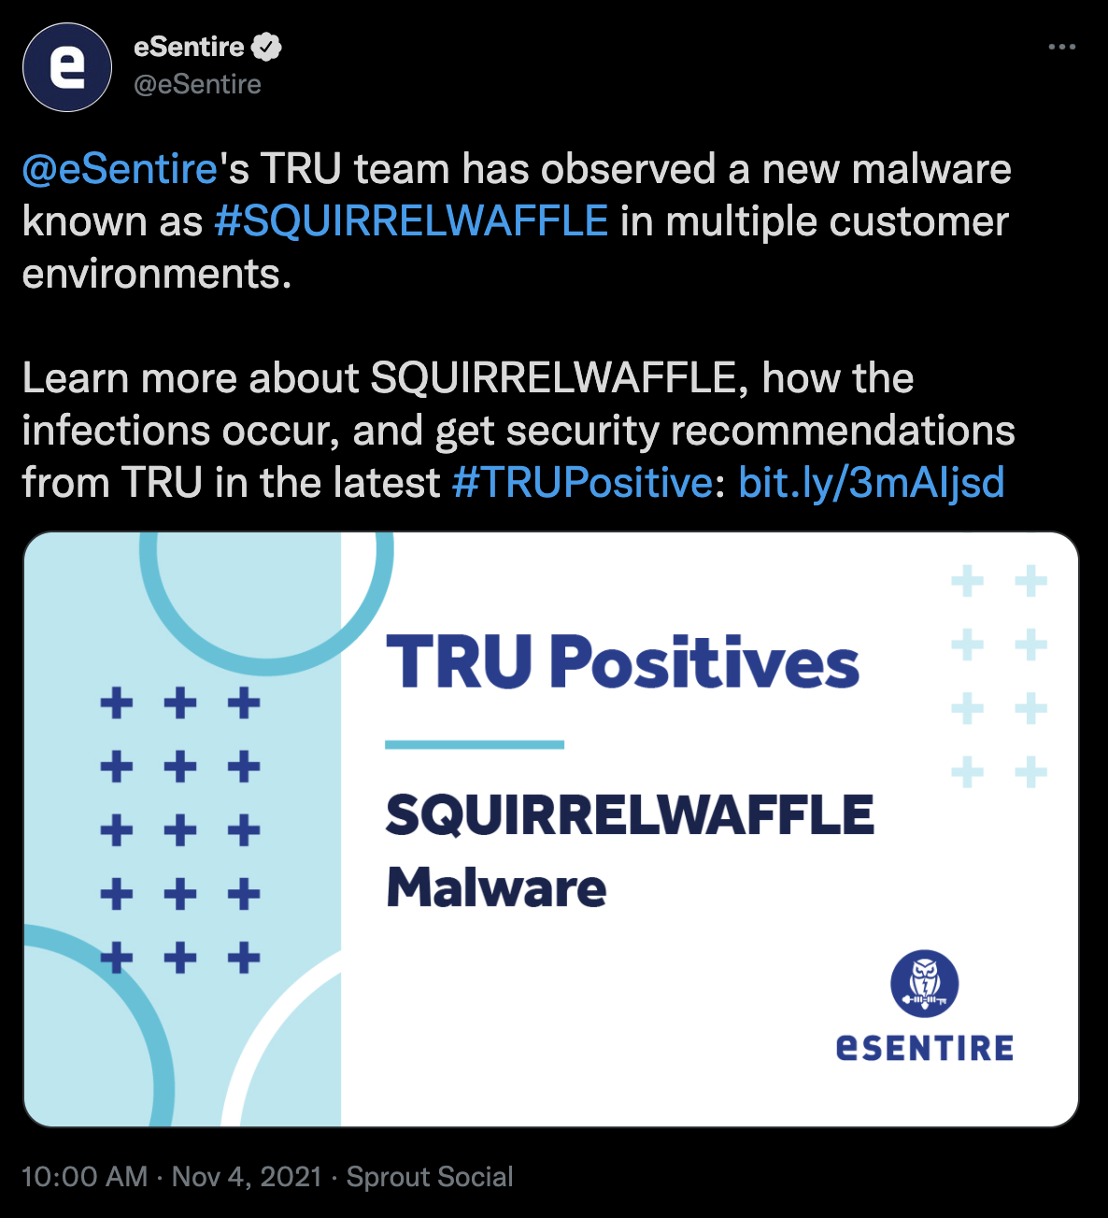
eSentire Bests Mandiant & FBI Notification of SQUIRRELWAFFLE
Demonstrates Proactive Threat Hunting, IOC Sweeps and Extreme Time to Value in Complete Response
Nov 5 – eSentire customer contacted by Mandiant/FBI regarding malware download activity in their environment
Nov 5 – eSentire team assigned to review findings and support the investigation
Nov 5 – confirmed that this was a duplicate incident that was already detected, investigated and remediated by eSentire on November 1
In fact, eSentire had already communicated our findings industry-wide in a TRU Positive investigation analysis on the SQUIRRELWAFFLE malware on November 4th
So how were we able to detect and respond before the FBI or Mandiant even noticed?
Our Threat Response Unit (TRU) delivers original research, performs threat analysis and builds content/models to help detect emerging threats
We were actively investigating the SQUIRRELWAFFLE malware and performed a proactive IOC Sweep across our global customer base as part of operationalizing the Threat Intelligence TRU curated
As a result of this proactive effort, we detected malware in this specific environment that had gone unnoticed by its endpoint coverage thus far

Slide 18
Innovation and Entrepreneurship are in our DNA
Our culture is built on speed, transparency and service excellence. Here’s where our roadmap is headed…
SIRP Services Including IR Retainer Offering, TableTop Exercises and Cyber War Games
Dark Web & Digital Risk Monitoring Service Available 24/7 or on Quarterly Basis
Premium Phishing & SAT Campaign Offering With Customized Incentive & Training Workflows
Identity-Based Response Across Microsoft, Okta, PING, and more

Slide 19
eSentire In Action: The SunWalker Incident – 8 Hours In Battle
eSentire SOC & Threat Response Unit defend an online education institution with eSentire MDR
RANSOMWARE BATTLE
While the SOC and TRU team monitor the attacker performing additional reconnaissance, they block attempts to deploy Netwalker ransomware. The endpoint is isolated, uninstaller disrupted, and attack thwarted.
Detection of the PowerShell attack, and manual response initiated by eSentire.
Attacker returns, logging into a second machine with stolen credentials. Drops ransomware disk and attempts to deploy SunCrypt Ransomware with lateral tool transfer.
Detection rule in VMCB endpoint alerted eSentire SOC to potential malicious activity.
VPN identified as attack vector, and VPN tunnels disabled.
00:00
00:15
01:05
07:30
08:00
CONCLUSION.
RED ALERT MAINTAINED OVER 24 HOURS.
00:10
01:00
03:30
07:40
07:45
SOC recognized active intruder, isolated the host & escalated to Threat Response Unit (TRU) for investigation.
Attacker leveraged stolen credentials to re-enter endpoint “zero” and executed an attack to steal additional credentials (Mimikatz).
TRU uncovers stealthy backdoor planted on domain controller. Remediation & recovery support provided.
Ransomware attempts detected and automatically blocked. Defense teams stand by given escalated activities.
Frustrated, the attacker changes tactics and downloads the Revo Uninstaller to disable the endpoint protection.
LESSONS LEARNED
An effective defensive posture requires process, technology but most importantly human expertise for combat-level containment and response
You can’t battle these attackers alone - eSentire MDR’s response was balanced with automated platform disruptions and TRU/SOC team investigation & manual containment, far beyond the customer’s resources/in house-capabilities
Multi-layered defense is required to combat sophisticated ransomware attacks - eSentire response to this incident included: endpoint monitoring/investigation, infrastructure and indicator research, next generation AV response, network monitoring/investigation, account monitoring, exfiltration investigation and manual defensive actions over an 8 hour period
There is significant value to data correlation from a service provider - eSentire Security Network Effects came into play as applicable external facing IP addresses leveraged for contact were applied to Global Deny List improving detections across our global client base

Slide 20
eSentire In Action: Detecting and Containing the Original Kaseya Zero-Day
eSentire was first to identify major MSP breach affecting 1000+ systems in 2018
INITIAL INCIDENT
January 19, 2018
CONTINUED SUPPORT
Until February 16, 2018 (27 Days)
Following their own investigation, customer MSP indicates additional evidence of hostile activity.
eSentire confirms the attacker set cryptocurrency miner and additional payloads to be injected in 2 days (”low and slow” tactics)
The next day, eSentire discovered the same malicious activity in a second customer a different MSP. This lead analysts to identify Kaseya Virtual Systems Administrator (VSA) as a common link.
A zero-day vulnerability in Kaseya’s VSA was ultimately determined to be the initial attack vector.
The scale of the breach is ultimately revealed 1,190 systems across the MSP’s client base. eSentire and client MSP coordinate to re-image impacted endpoints and compile forensic details. The investigation was closed by eSentire on January 24th (Day 5).
The threat actor attempted to return with new mining tools despite patching efforts from Kaseya. eSentire tracked the activity up until a second patch was released in mid-February.
BlueSteel ML model detects PowerShell mining bundle in single client. Customer notified.
00:00
07:13
07:40
00:29
07:23
09:53
SOC Investigation continues.
Customer elects to not quarantine endpoint so customer MSP can investigate.
eSentire SOC quarantines the customer’s host device to prevent lateral spread.
Investigation reveals alpha infection started outside the eSentire client environment (an MSP customer)
LESSONS LEARNED
Attackers do not hesitate to “go back to the well” when targeting third parties strategically – we suspect this recent attack could be a variation on the same attack tactic they used in 2018, which we discovered.
Attackers are increasingly leveraging third parties, highly modular tools, and ”low and slow” techniques to achieve their objectives. This underscores the need for threat hunting and 24x7 advanced detection.
The ability to track and contain threats both immediately and over the span of weeks is critical as patching efforts are not always immediately effective
You can’t battle these attackers alone - eSentire MDR’s response was balanced with automated platform disruptions and TRU/SOC team investigation & manual containment, far beyond both the customer and customer MSP’s capabilities.

Slide 21
What’s Being Said About eSentire
GARTNER PEER INSIGHTS
“Exceptional on-boarding experience, quick and simple. An incredibly great Security Operations Centre at the heart of their product suite. Always developing their product to meet their customers’ needs. Some of the best customer relationship management I have ever experienced.”
SVP, Information Technology
Finance Industry
“I've been an eSentire customer from their early days and have implemented their products at a number of firms I've run technology for. Their capabilities have grown over that time dramatically and I consider them to be a trusted partner and extension of my team when it comes to our cybersecurity program.”
Head of Technology
Finance Industry
CUSTOMERS
“We have been leveraging the Atlas platform for some time now and were pleased to see how easy it was to add endpoint protection to the suite of services we receive through the platform. It required very little work from our IT team and provides an additional layer of peace of mind in today’s uncertain environment.”
Neil Waugh
Chief Information Officer
“Every time we call the eSentire SOC, we get a true security analyst on the first touch to walk us through our incidents clearly and efficiently. No other provider delivers such personalized service and expertise. Leveraging the eSentire Atlas platform, in conjunction with access to their sophisticated threat intelligence team, we have been able to cut our incident time to resolution in half.”
Michael Smith
Vice President, Director of Information Technology

Slide 22
There is no end to cyber risk. Go into battle with the best.
Industry Leading
Platform
24/7 Security
Expertise
Security Operations Leadership
Continuous Improvement Driving Security That Scales
Cloud native architecture to grow with your business
Multi-Signal Ingest for complete visibility and deep investigation
Machine learning models to eliminate the noise
Artificial Intelligence for Threat Hunting pattern recognition
Automated disruptions
Security Network Effects to harden your defenses
24/7 eyes on glass with SOC Cyber Analysts and Elite Threat Hunters
Extensive threat hunting and response capabilities
Technical advisement and risk reduction with Cyber Risk Advisor
TRU team expertise for analytics, detection models and original research
Time to value in days
Human-led threat investigations
15 min Mean Time To Contain
Enriched escalations with recommendations
Detection models rooted in MITRE attack framework
Real-time actionable intelligence from eSentire Insights Portal
Operational reporting to demonstrating ROI
Ecosystem inputs from TRU, SOC, Threat Hunters, MVS, IR and more to deliver security at scale
Atlas amplifies Security Network Effects that harden your defenses with every detection hundreds of times per day
Complete Strategic Service Support from Managed Risk, to MDR to IR
Security roadmap to reduce your risk and drive outcomes forward
Not all MDR is created equal.
eSentire delivers MDR³ – Response. Remediation. Results.

Slide 23
Alex Jinivizian
VP of Strategy & Corporate Development
Alex.jinivizian@esentire.com
@esentire
LinkedIn.com/esentire-inc

